Slide 1
Lecture 2: Mixed-effects models
Learning goals:
Learn why maximum marginal likelihood useful
Learn why Stein’s paradox is a paradox
Learn what is shrinkinage

Slide 2
How do we estimate things?
Specify a model
Function generating predictions
Identify plausible values for any unknown parameters
Maximize probability of observations given function
Assess uncertainty
Explore function around plausible values

Slide 3
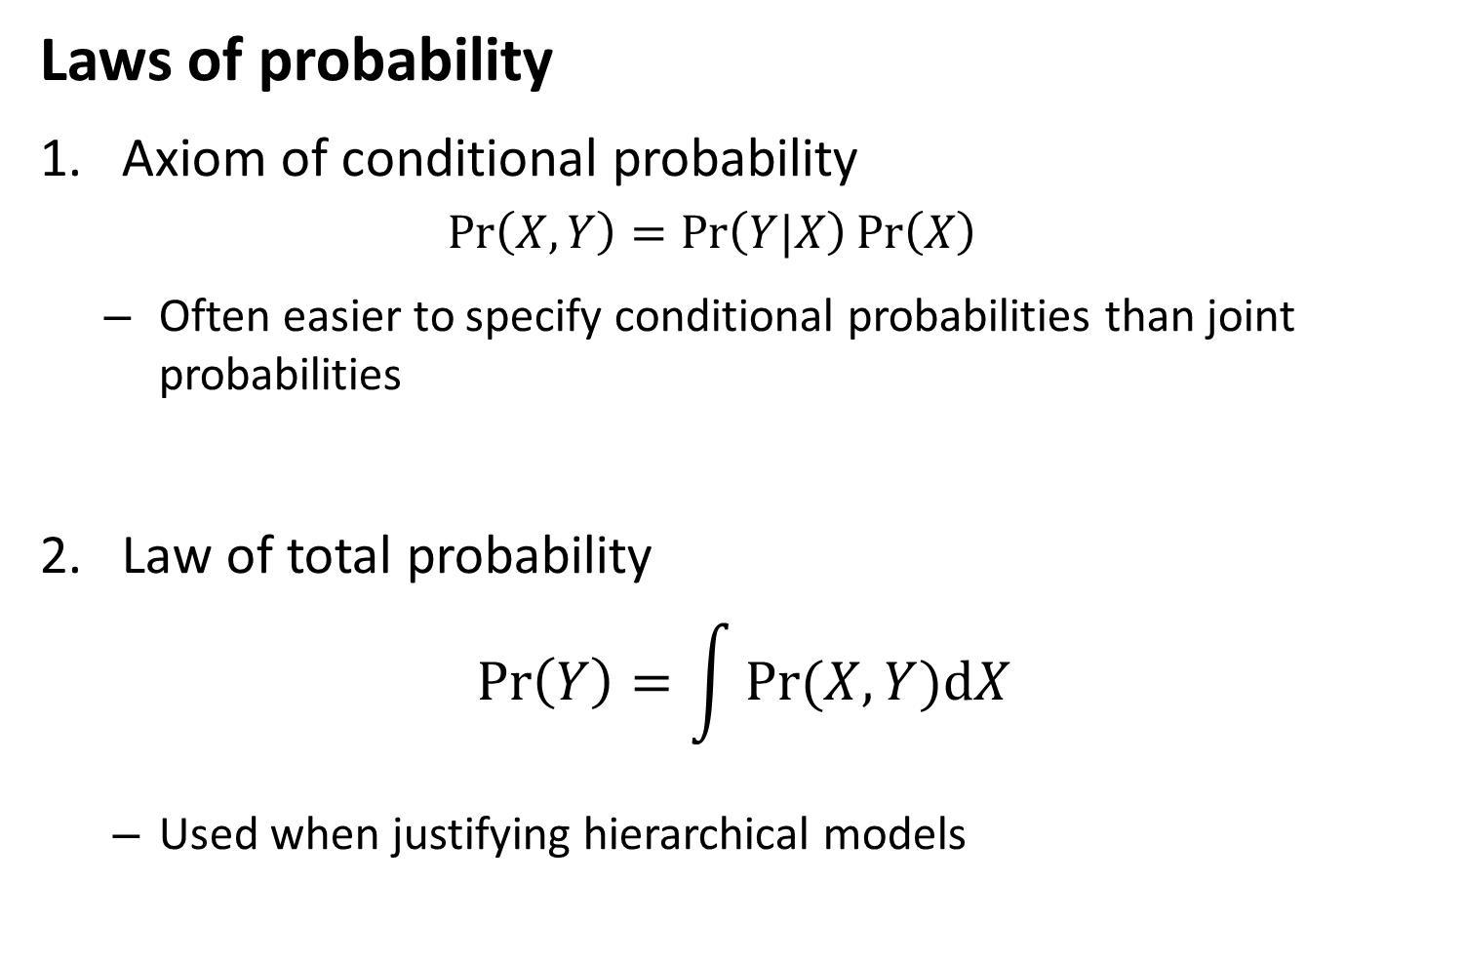
Laws of probability
Axiom of conditional probability
$$\operatorname{Pr}\left(X,Y\right)=\operatorname{Pr}\left(Y|X\right)\operatorname{Pr}\left(X\right)$$
Often easier to specify conditional probabilities than joint probabilities
Law of total probability
$$\operatorname{Pr}\left(Y\right)=\int{Pr⁡(X,Y)dX}$$
Used when justifying hierarchical models

Slide 4
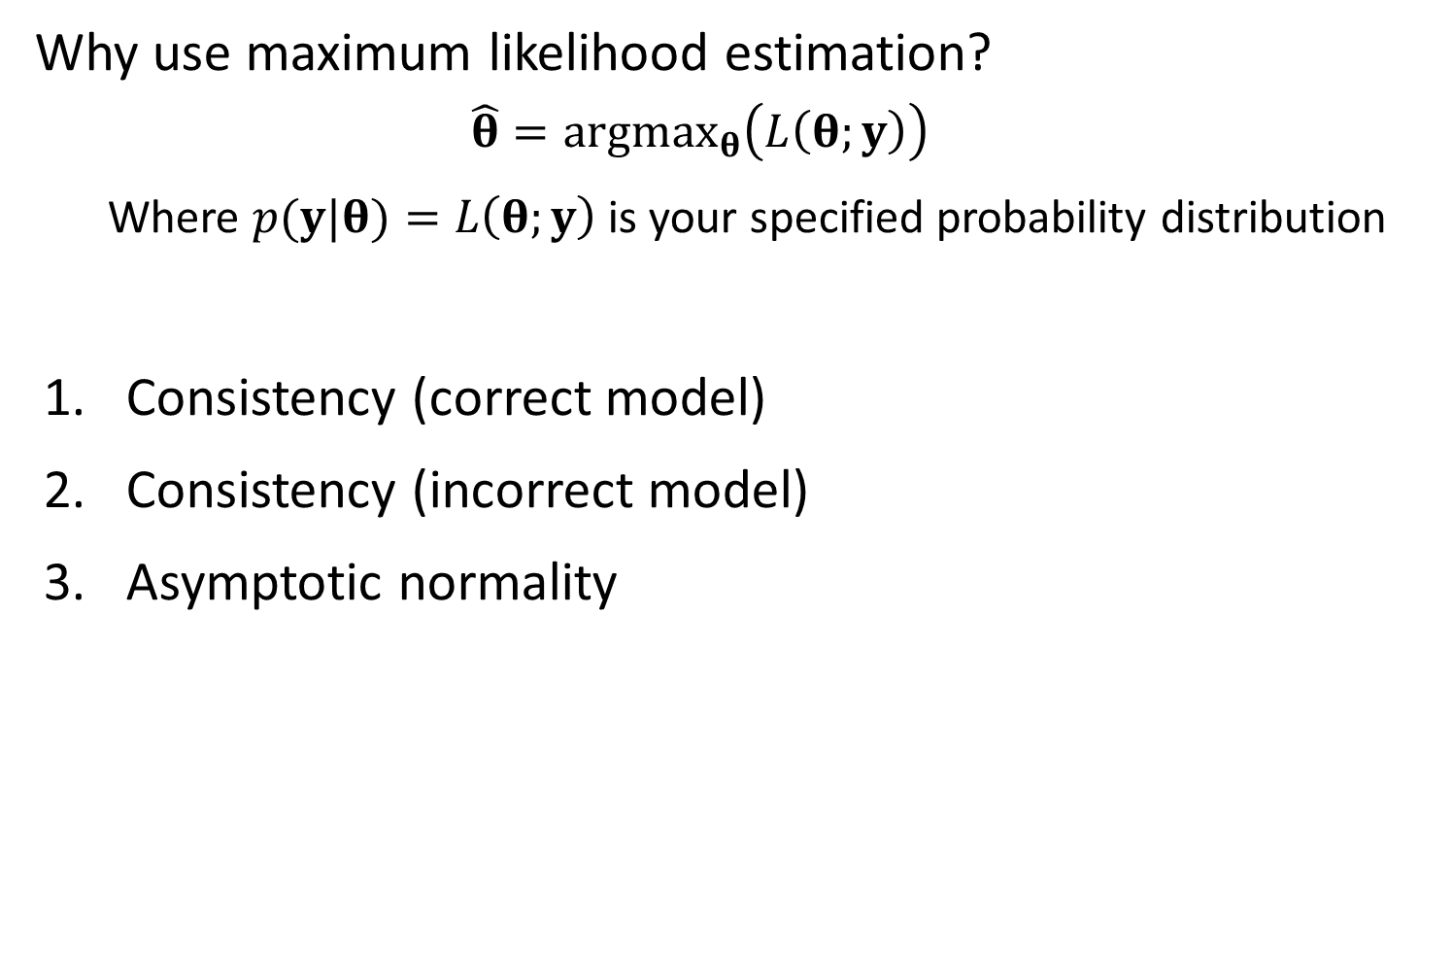
Why use maximum likelihood estimation?
$$\hat{θ}=argmax_{θ}\left(L\left(θ;y\right)\right)$$
Where $p(y|θ)=L\left(θ;y\right)$ is your specified probability distribution
Consistency (correct model)
Consistency (incorrect model)
Asymptotic normality

Slide 5
Likelihood statistics
Problem:
We often can’t write the probability of data given parameters
Examples:
Tag-recapture
What’s the probability of tagging an animal in 2008, seeing it again in 2010 and 2011, and then never seeing it again?
Time-series
What’s the probability distribution for escapement of chinook salmon in the snake river in 2011, given that you’ve sampled escapement from 1980-2010?
Occupancy
Three volunteers look for an endangered butterfly at a site, and only two find it. These volunteers sample at a new site, and none see the butterfly. What is the probability that is present but wasn’t detected?

Slide 6
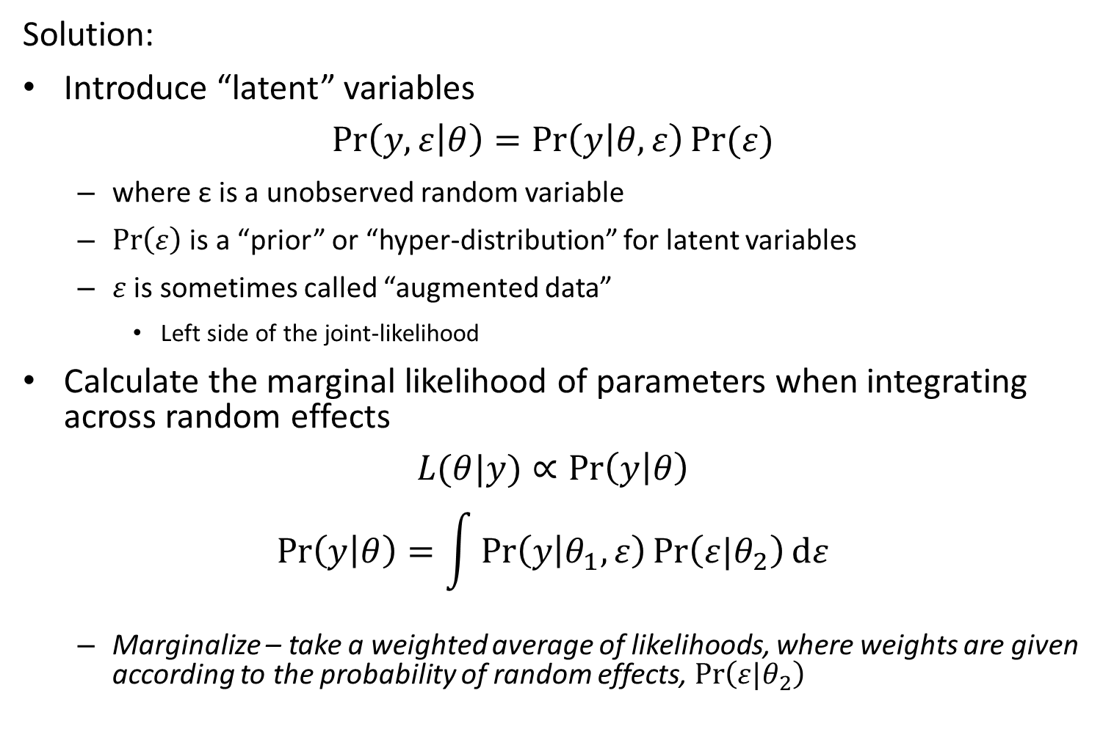
Likelihood statistics
Solution:
Introduce “latent” variables
$$\operatorname{Pr}\left(y,ε | θ\right)=\operatorname{Pr}\left(y | θ,ε\right)Pr⁡(ε)$$
where ε is a unobserved random variable
$\operatorname{Pr}\left(ε\right)$ is a “prior” or “hyper-distribution” for latent variables
$ε$ is sometimes called “augmented data”
Left side of the joint-likelihood
Calculate the marginal likelihood of parameters when integrating across random effects
$$L(θ|y)∝\operatorname{Pr}\left(y | θ\right)$$
$$\operatorname{Pr}\left(y | θ\right)=\int{\operatorname{Pr}\left(y | θ_{1},ε\right)\operatorname{Pr}\left(ε|θ_{2}\right)dε}$$
Marginalize – take a weighted average of likelihoods, where weights are given according to the probability of random effects, $\operatorname{Pr}\left(ε|θ_{2}\right)$

Slide 7
Definitions
Term | Definition
Random effect | Coefficient that is “exchangeable” with one or more other coefficients
Hyperdistribution | Distribution for “exchangeable” random effects
Exchangeable | No information is available to distinguish between residual variability in random effects
Fixed effect | Coefficient that is not exchangeable with others, and which hence is estimated without a hyperdistribution
Mixed-effect model | Model with both fixed and random effects

Slide 8
Likelihood statistics
Why would you make a hierarchy of parameters
Biological intuition – Formulate models based on knowledge of constituent parts (Burnham and Anderson 2008)
Variance partitioning – Separate different sources of variability (e.g., measurement errors!)
Shrinkage – Often improve precision from assuming parameters arise from a distribution

Slide 9
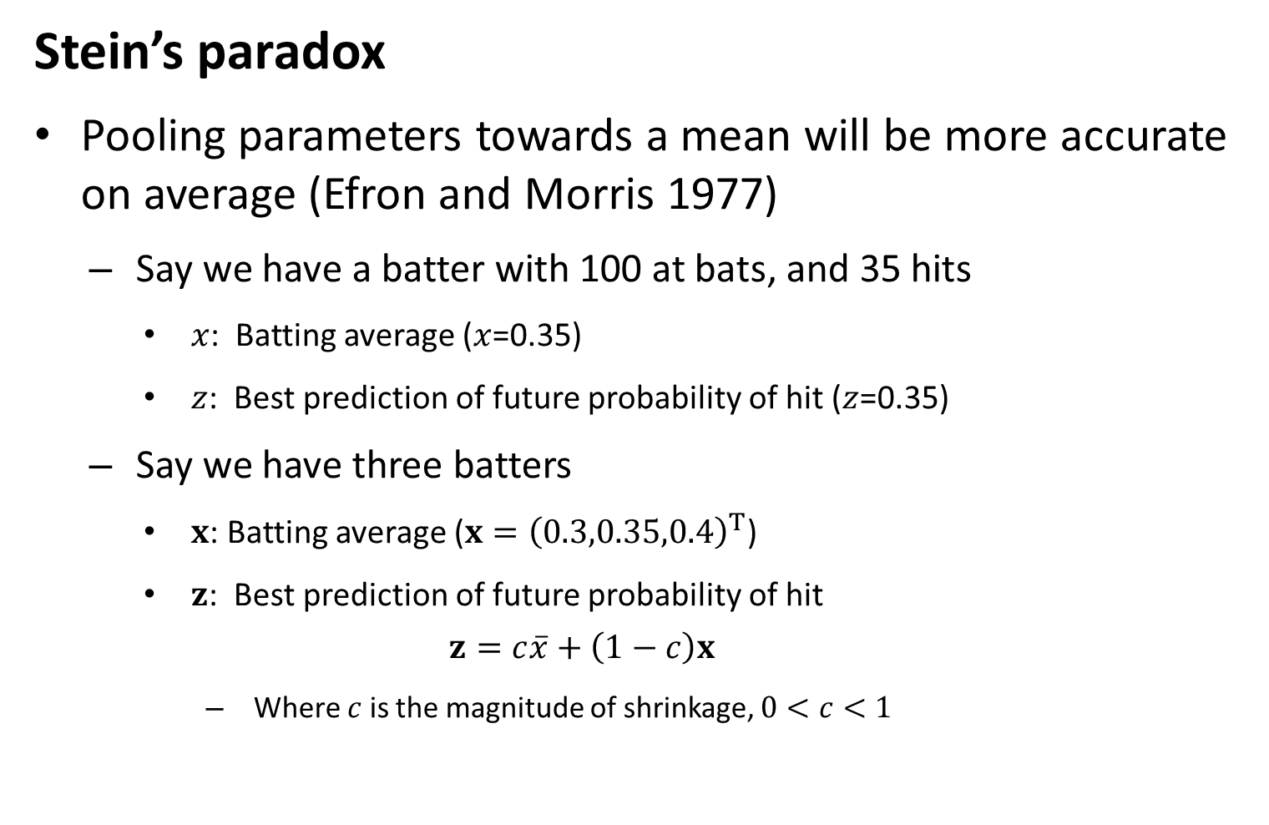
Likelihood statistics
Stein’s paradox
Pooling parameters towards a mean will be more accurate on average (Efron and Morris 1977)
Say we have a batter with 100 at bats, and 35 hits
$x$: Batting average ($x$=0.35)
$z$: Best prediction of future probability of hit ($z$=0.35)
Say we have three batters
$x$: Batting average ($x={\left(0.3,0.35,0.4\right)}^{T}$)
$z$: Best prediction of future probability of hit
$$z=c\overline{x}+\left(1−c\right)x$$
Where $c$ is the magnitude of shrinkage, $0<c<1$

Slide 10
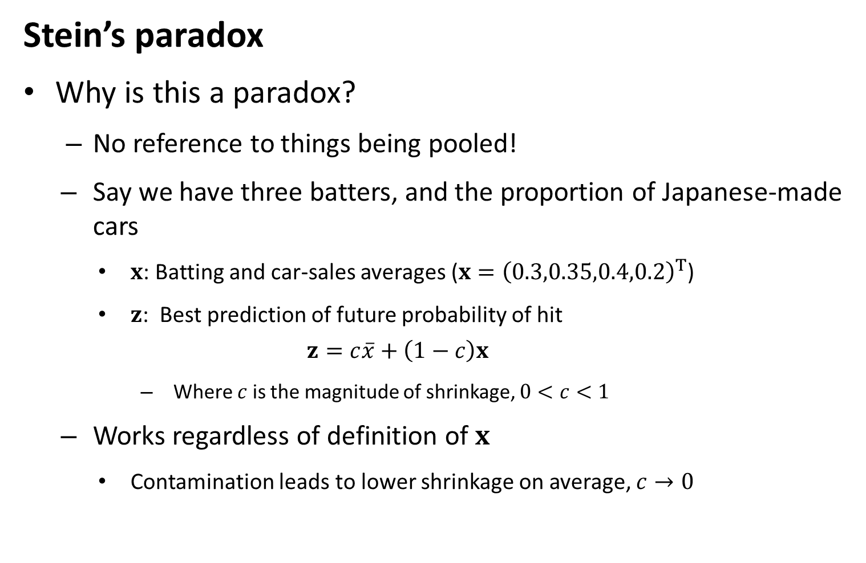
Likelihood statistics
Stein’s paradox
Why is this a paradox?
No reference to things being pooled!
Say we have three batters, and the proportion of Japanese-made cars
$x$: Batting and car-sales averages ($x={\left(0.3,0.35,0.4,0.2\right)}^{T}$)
$z$: Best prediction of future probability of hit
$$z=c\overline{x}+\left(1−c\right)x$$
Where $c$ is the magnitude of shrinkage, $0<c<1$
Works regardless of definition of $x$
Contamination leads to lower shrinkage on average, $c→0$

Slide 11
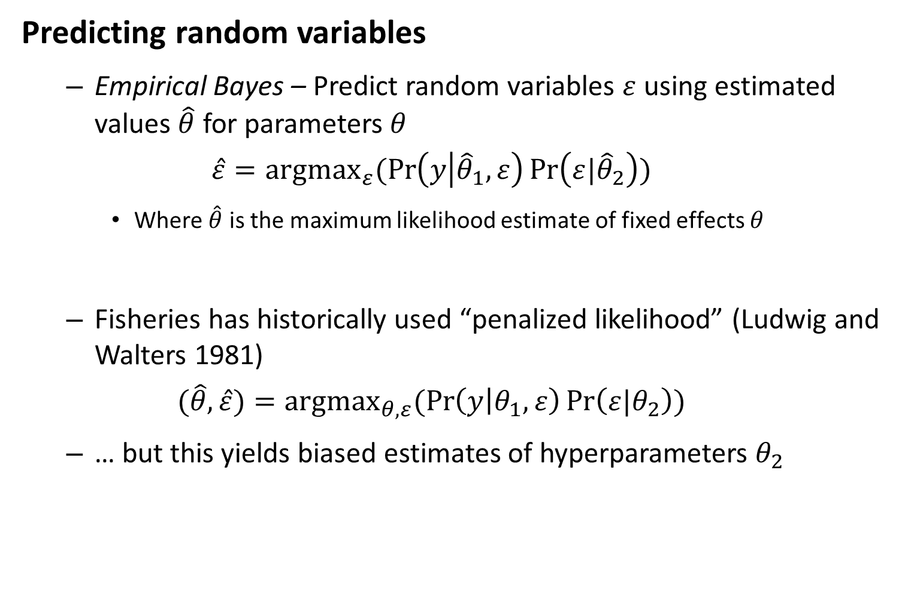
Likelihood statistics
Predicting random variables
Empirical Bayes – Predict random variables $ε$ using estimated values $\hat{θ}$ for parameters $θ$
$$\hat{ε}={argmax}_{ε}(\operatorname{Pr}\left(y | {\hat{θ}}_{1},ε\right)\operatorname{Pr}\left(ε|{\hat{θ}}_{2}\right))$$
Where $\hat{θ}$ is the maximum likelihood estimate of fixed effects $θ$
Fisheries has historically used “penalized likelihood” (Ludwig and Walters 1981)
$$(\hat{θ},\hat{ε})={argmax}_{θ,ε}(\operatorname{Pr}\left(y | θ_{1},ε\right)\operatorname{Pr}\left(ε|θ_{2}\right))$$
… but this yields biased estimates of hyperparameters $θ_{2}$

Slide 12
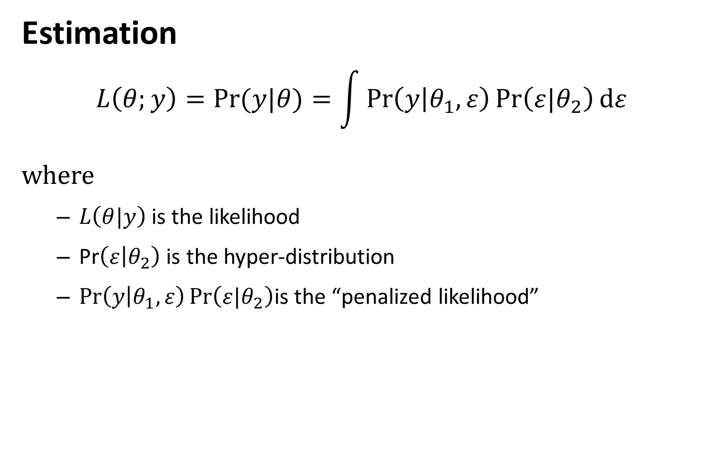
Likelihood statistics
Estimation
$$L\left(θ;y\right)=Pr⁡(y|θ)=\int{\operatorname{Pr}\left(y | θ_{1},ε\right)\operatorname{Pr}\left(ε|θ_{2}\right)dε}$$
where
$L\left(θ|y\right)$ is the likelihood
Pr$\left(ε | θ_{2}\right)$ is the hyper-distribution
$\operatorname{Pr}\left(y | θ_{1},ε\right)\operatorname{Pr}\left(ε|θ_{2}\right)$is the “penalized likelihood”

Slide 13
How do we estimate the marginal likelihood?
“Hierarchical Bayes”
Generally involves MCMC
Already integrating across parameters, so integrates across latent variables automatically
“Maximum marginal likelihood”
Use the “Laplace approximation” to approximate integral
Use alternating estimation of fixed and random effects
“Inner optimization” – Optimize random effects given fixed effects
“Outer optimization” – Optimize fixed effects given random effects

Slide 14
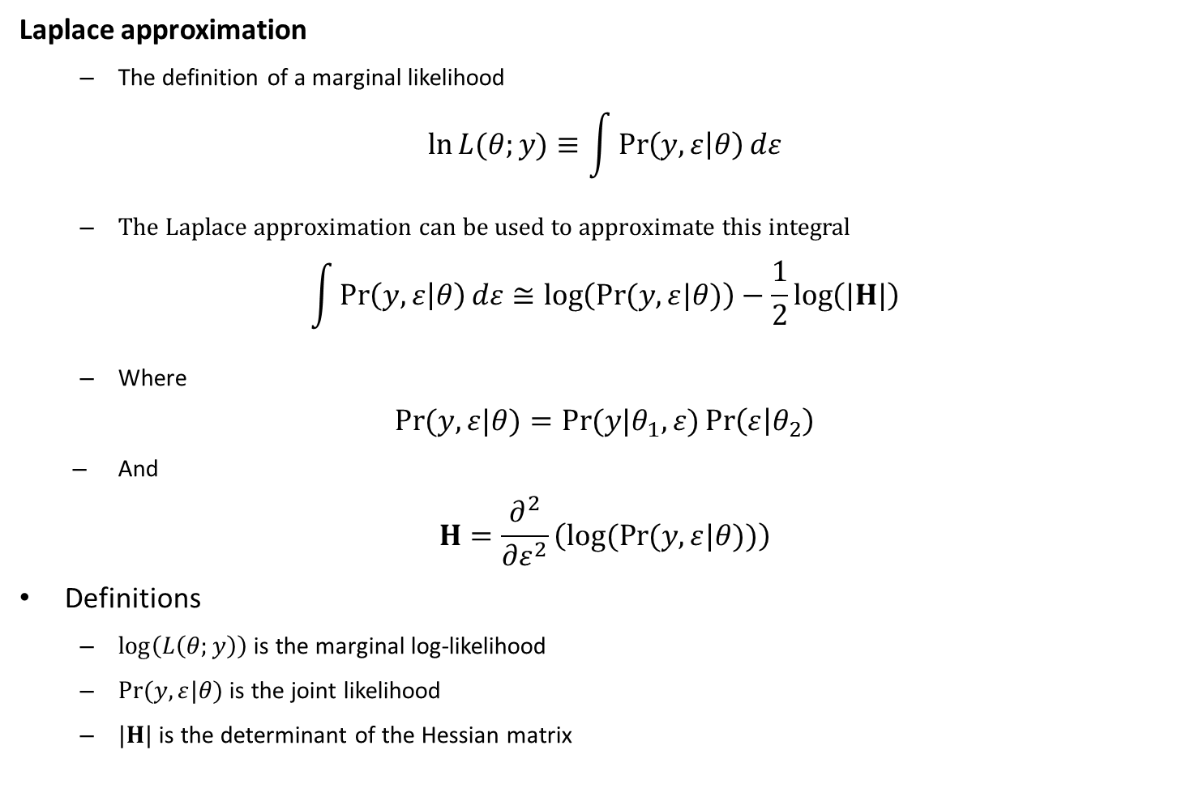
Likelihood statistics
Laplace approximation
The definition of a marginal likelihood
$$\ln{L{(θ;y)}}≡\int{\operatorname{Pr}\left(y,ε | θ\right)dε}$$
The Laplace approximation can be used to approximate this integral
$$\int{\operatorname{Pr}\left(y,ε | θ\right)dε}≅\log\left(\operatorname{Pr}{(y,ε|θ)}\right)−\frac{1}{2}\log\left(|H|\right)$$
Where
$$\operatorname{Pr}{(y,ε|θ)}=\operatorname{Pr}{(y|θ_{1},ε)}\operatorname{Pr}\left(ε | θ_{2}\right)$$
And
$$H=\frac{∂^{2}}{∂ε^{2}}\left(log(Pr{(y,ε|θ))}\right)$$
Definitions
$\log\left(L\left(θ;y\right)\right)$ is the marginal log-likelihood
$\operatorname{Pr}{(y,ε|θ)}$ is the joint likelihood
$|H|$ is the determinant of the Hessian matrix

Slide 15
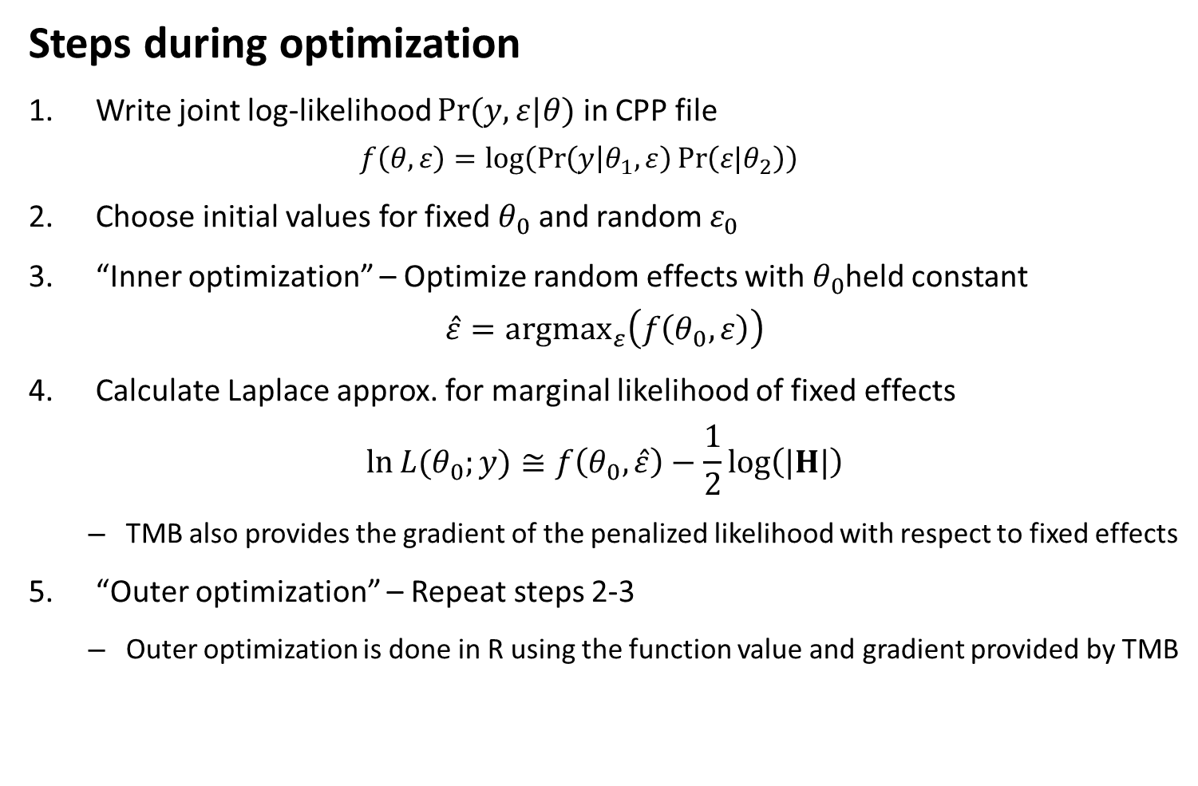
TMB
Steps during optimization
Write joint log-likelihood $\operatorname{Pr}{(y,ε|θ)}$ in CPP file
$$f\left(θ,ε\right)=log⁡\left(\operatorname{Pr}\left(y | θ_{1},ε\right)\operatorname{Pr}\left(ε|θ_{2}\right)\right)$$
Choose initial values for fixed $θ_{0}$ and random $ε_{0}$
“Inner optimization” – Optimize random effects with $θ_{0}$held constant
$$\hat{ε}={argmax}_{ε}\left(f\left(θ_{0},ε\right)\right)$$
Calculate Laplace approx. for marginal likelihood of fixed effects
$$\ln{L{(θ_{0};y)}}≅f\left(θ_{0},\hat{ε}\right)−\frac{1}{2}\log\left(|H|\right)$$
TMB also provides the gradient of the penalized likelihood with respect to fixed effects
“Outer optimization” – Repeat steps 2-3
Outer optimization is done in R using the function value and gradient provided by TMB

Slide 16
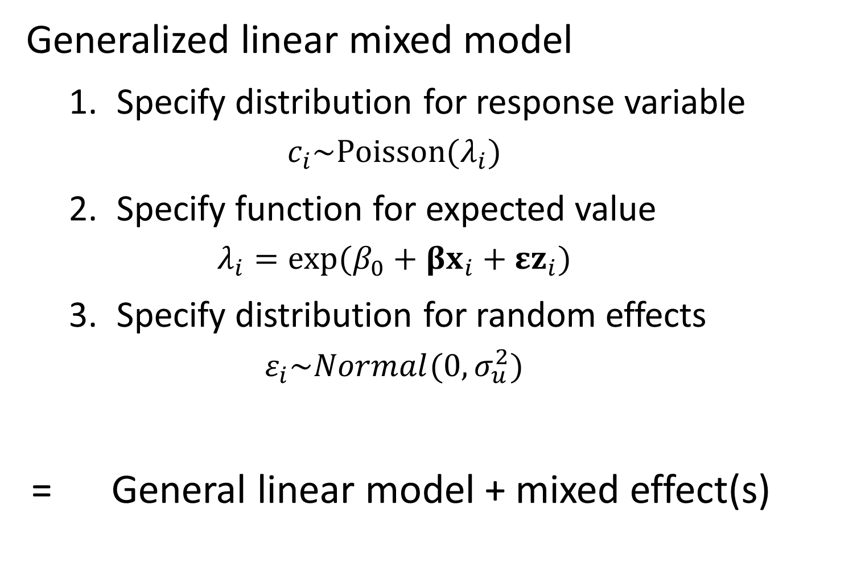
Generalized linear mixed model
Specify distribution for response variable
$$c_{i}\sim Poisson(λ_{i})$$
Specify function for expected value
$$λ_{i}=exp⁡(β_{0}+βx_{i}+εz_{i})$$
Specify distribution for random effects
$$ε_{i}\sim Normal(0,σ_{u}^{2})$$
= General linear model + mixed effect(s)

Slide 17
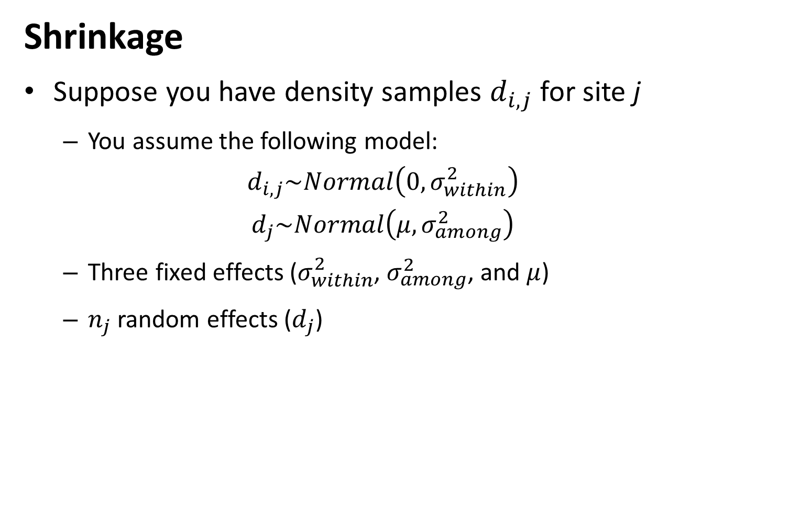
Shrinkage
Suppose you have density samples $d_{i,j}$ for site j
You assume the following model:
$$d_{i,j}\sim Normal\left(0,σ_{within}^{2}\right)$$
$$d_{j}\sim Normal\left(μ,σ_{among}^{2}\right)$$
Three fixed effects ($σ_{within}^{2}$, $σ_{among}^{2}$, and $μ$)
$n_{j}$ random effects ($d_{j}$)

Slide 18

Shrinkage
Estimated random effects are weighted average of global mean and group mean
Optimal predictor
$${\hat{d}}_{j}=c\overline{d}+(1−c){\overline{d}}_{j}$$
Where
$$c=\frac{{\hat{w}}_{1}}{{\hat{w}}_{1}+{\hat{w}}_{2,j}}$$
$${\hat{w}}_{1}=\frac{1}{σ_{among}^{2}}$$
$${\hat{w}}_{2}=\frac{n_{j}}{σ_{within}^{2}}$$
And where
$σ_{among}^{2}$ is the variance in $d_{j}$ among groups
$σ_{within}^{2}$ is the variance of density samples within a given group
${\overline{d}}_{j}$ is the sample mean for group j
$\overline{d}$ is the sample mean for ${\overline{d}}_{j}$ for all groups

Slide 19
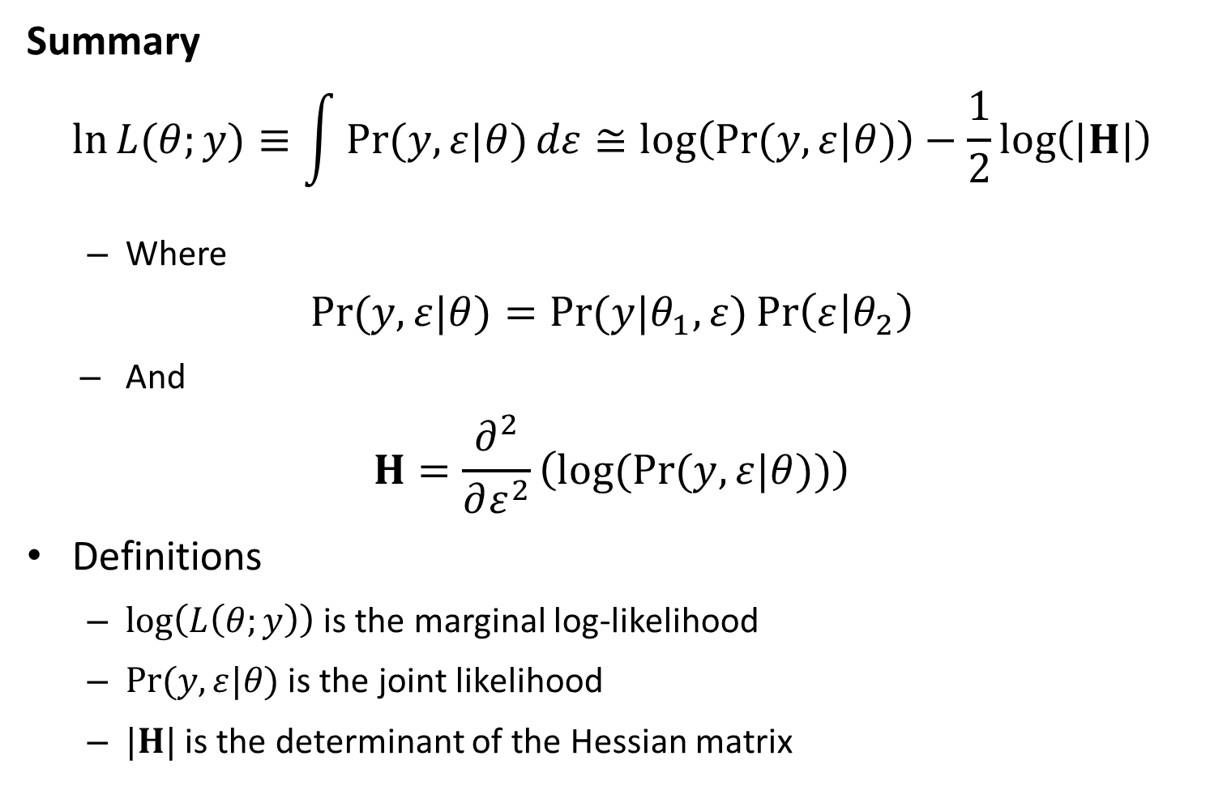
Likelihood statistics
Summary
$$\ln{L{(θ;y)}}≡\int{\operatorname{Pr}{(y,ε|θ)}dε}≅\log\left(\operatorname{Pr}{(y,ε|θ)}\right)−\frac{1}{2}\log\left(|H|\right)$$
Where
$$\operatorname{Pr}{(y,ε|θ)}=\operatorname{Pr}{(y|θ_{1},ε)}\operatorname{Pr}\left(ε | θ_{2}\right)$$
And
$$H=\frac{∂^{2}}{∂ε^{2}}\left(log(Pr{(y,ε|θ))}\right)$$
Definitions
$\log\left(L\left(θ;y\right)\right)$ is the marginal log-likelihood
$\operatorname{Pr}{(y,ε|θ)}$ is the joint likelihood
$|H|$ is the determinant of the Hessian matrix

Slide 20
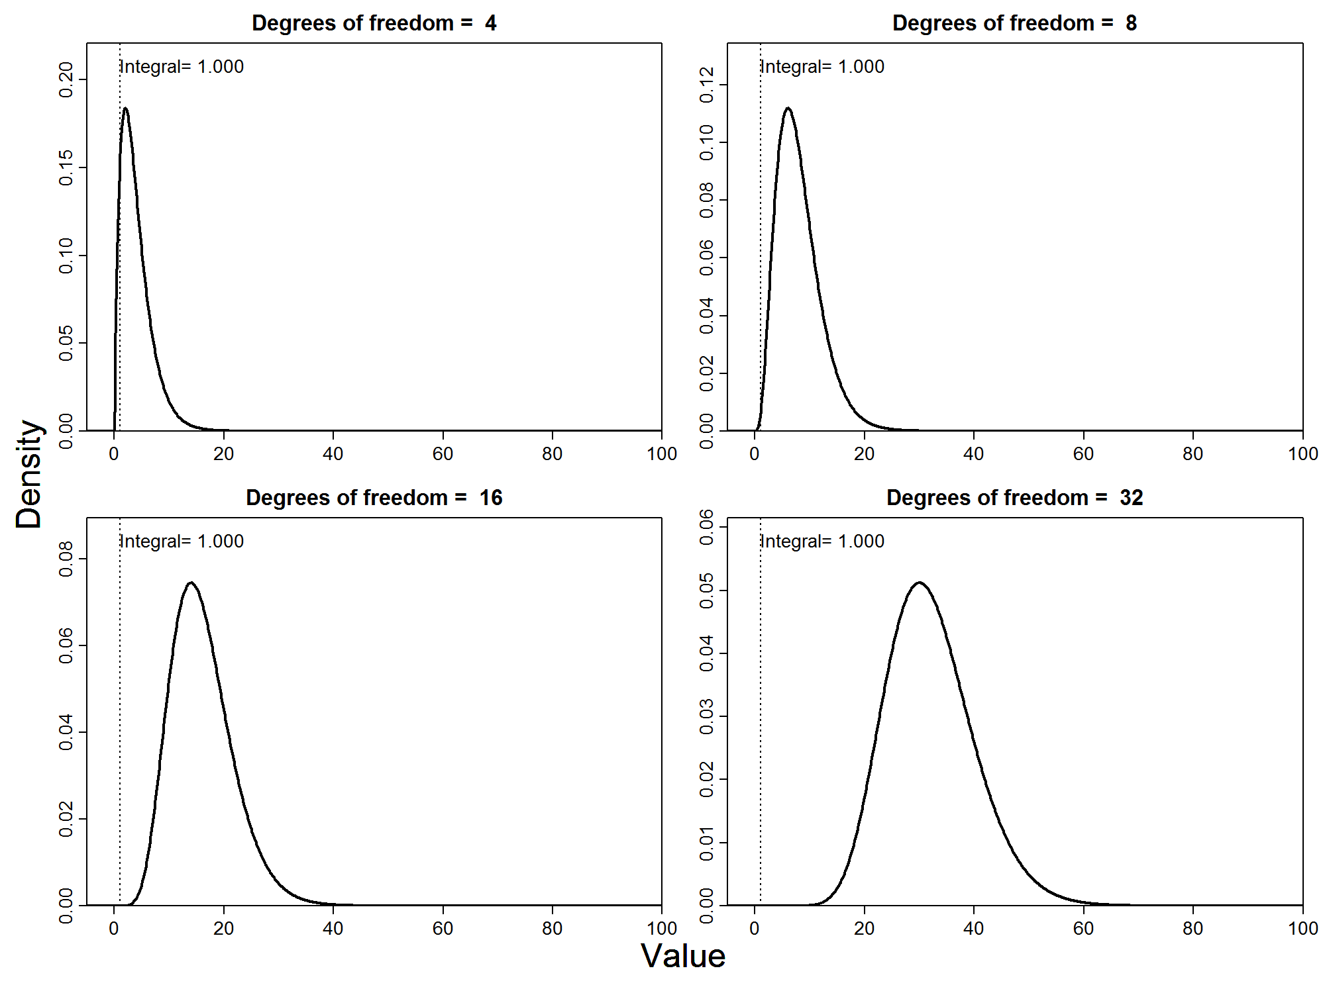

Slide 21
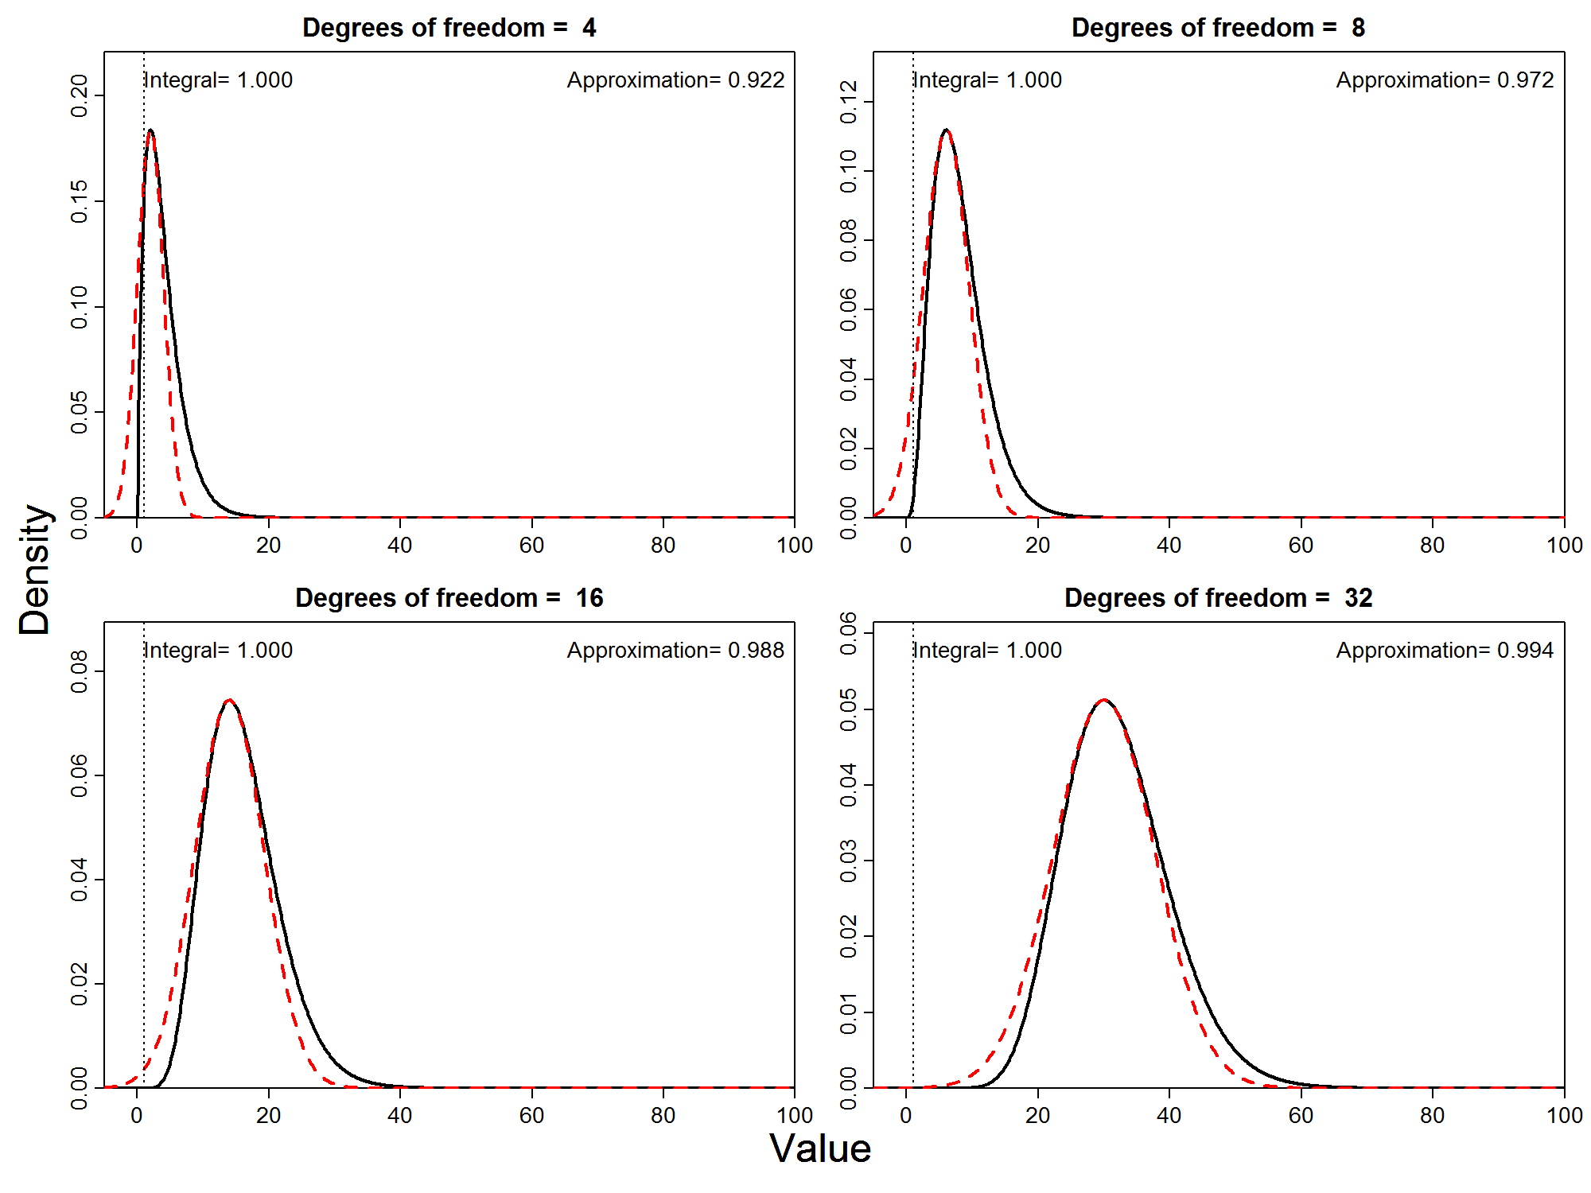

Slide 22
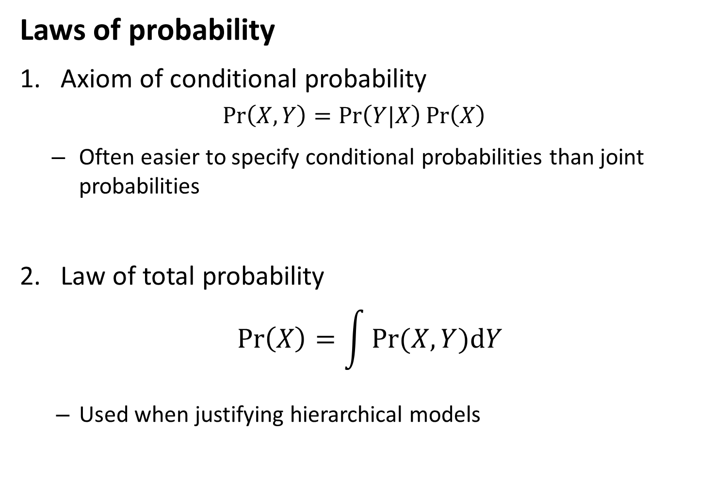
Mixed-effects models
Laws of probability
Axiom of conditional probability
$$\operatorname{Pr}\left(X,Y\right)=\operatorname{Pr}\left(Y|X\right)\operatorname{Pr}\left(X\right)$$
Often easier to specify conditional probabilities than joint probabilities
Law of total probability
$$\operatorname{Pr}\left(X\right)=\int{Pr⁡(X,Y)dY}$$
Used when justifying hierarchical models

Slide 23
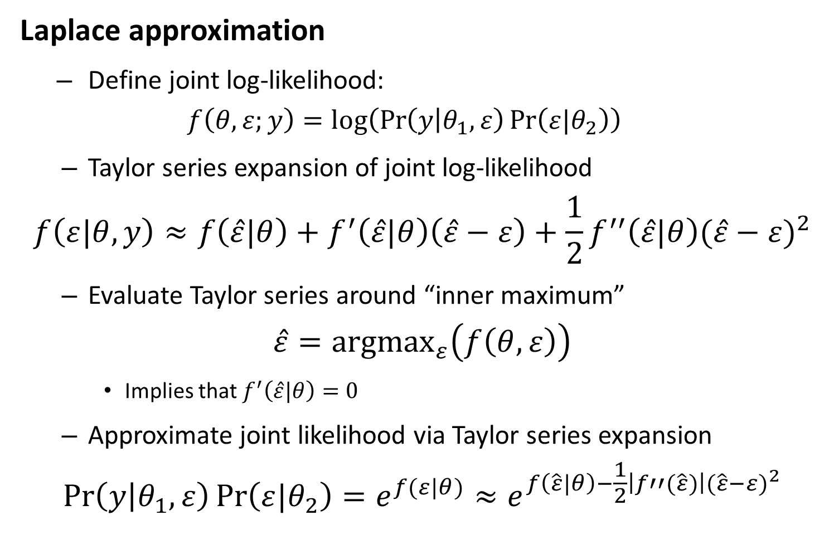
Likelihood statistics
Laplace approximation
Define joint log-likelihood:
$$f\left(θ,ε;y\right)=log⁡\left(\operatorname{Pr}\left(y | θ_{1},ε\right)\operatorname{Pr}\left(ε|θ_{2}\right)\right)$$
Taylor series expansion of joint log-likelihood
$$f\left(ε|θ,y\right)≈f\left(\hat{ε}|θ\right)+f^{′}\left(\hat{ε}|θ\right)\left(\hat{ε}−ε\right)+\frac{1}{2}f^{′′}\left(\hat{ε}|θ\right){(\hat{ε}−ε)}^{2}$$
Evaluate Taylor series around “inner maximum”
$$\hat{ε}={argmax}_{ε}\left(f\left(θ,ε\right)\right)$$
Implies that $f^{′}\left(\hat{ε}|θ\right)=0$
Approximate joint likelihood via Taylor series expansion
$$\operatorname{Pr}\left(y | θ_{1},ε\right)\operatorname{Pr}\left(ε|θ_{2}\right)=e^{f(ε|θ)}≈e^{f\left(\hat{ε}|θ\right)−\frac{1}{2}\left|f′′(\hat{ε})\right|{(\hat{ε}−ε)}^{2}}$$

Slide 24
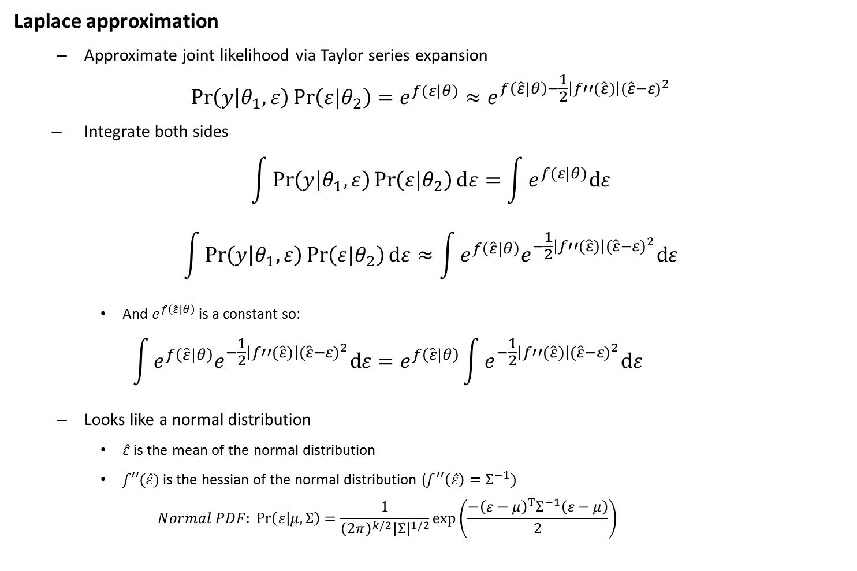
Likelihood statistics
Laplace approximation
Approximate joint likelihood via Taylor series expansion
$$\operatorname{Pr}\left(y | θ_{1},ε\right)\operatorname{Pr}\left(ε|θ_{2}\right)=e^{f(ε|θ)}≈e^{f\left(\hat{ε}|θ\right)−\frac{1}{2}\left|f′′(\hat{ε})\right|{(\hat{ε}−ε)}^{2}}$$
Integrate both sides
$$\int{\operatorname{Pr}\left(y | θ_{1},ε\right)\operatorname{Pr}\left(ε|θ_{2}\right)dε}=\int{e^{f(ε|θ)}dε}$$
$$\int{\operatorname{Pr}\left(y | θ_{1},ε\right)\operatorname{Pr}\left(ε|θ_{2}\right)dε}≈\int{e^{f\left(\hat{ε}|θ\right)}e^{−\frac{1}{2}\left|f′′(\hat{ε})\right|{(\hat{ε}−ε)}^{2}}dε}$$
And $e^{f\left(\hat{ε}|θ\right)}$ is a constant so:
$$\int{e^{f\left(\hat{ε}|θ\right)}e^{−\frac{1}{2}\left|f′′(\hat{ε})\right|{(\hat{ε}−ε)}^{2}}dε}=e^{f\left(\hat{ε}|θ\right)}\int{e^{−\frac{1}{2}\left|f′′(\hat{ε})\right|{(\hat{ε}−ε)}^{2}}dε}$$
Looks like a normal distribution
$\hat{ε}$ is the mean of the normal distribution
$f′′(\hat{ε})$ is the hessian of the normal distribution ($f^{′′}\left(\hat{ε}\right)=Σ^{−1})$
$$Normal PDF: \operatorname{Pr}\left(ε | μ,Σ\right)=\frac{1}{{\left(2π\right)}^{k/2}{\left|Σ\right|}^{1/2}}exp⁡\left(\frac{−{\left(ε−μ\right)}^{T}Σ^{−1}\left(ε−μ\right)}{2}\right)$$

Slide 25

Likelihood statistics
Chi-squared example
$$X\sim Chi.Squared(k)$$
$$\operatorname{Pr}\left(X=x\right)∝x^{\frac{k}{2}−1}e^{\frac{−x}{2}}$$
Defining the log-likelihood
$$\log\left(\operatorname{Pr}\left(x\right)\right)∝f(x)$$
Taking derivatives:
$$f\left(x\right)∝\left(\frac{k}{2}−1\right)\log\left(x\right)−\frac{x}{2}$$
$$f′\left(x\right)∝\left(\frac{k}{2}−1\right)x^{−1}−\frac{1}{2}$$
$$f′′\left(x\right)∝−\left(\frac{k}{2}−1\right)x^{−2}$$
Solving for mode and Hessian:
$$f^{′}\left(x\right)=0 → \hat{x}=k−2$$
$$f′′\left(\hat{x}\right)=−\left(\frac{1}{2\left(k−2\right)}\right)$$
Hence:
$$\operatorname{Pr}{(x)}∝Normal(k−2, 2\left(k−2\right))$$

Slide 26
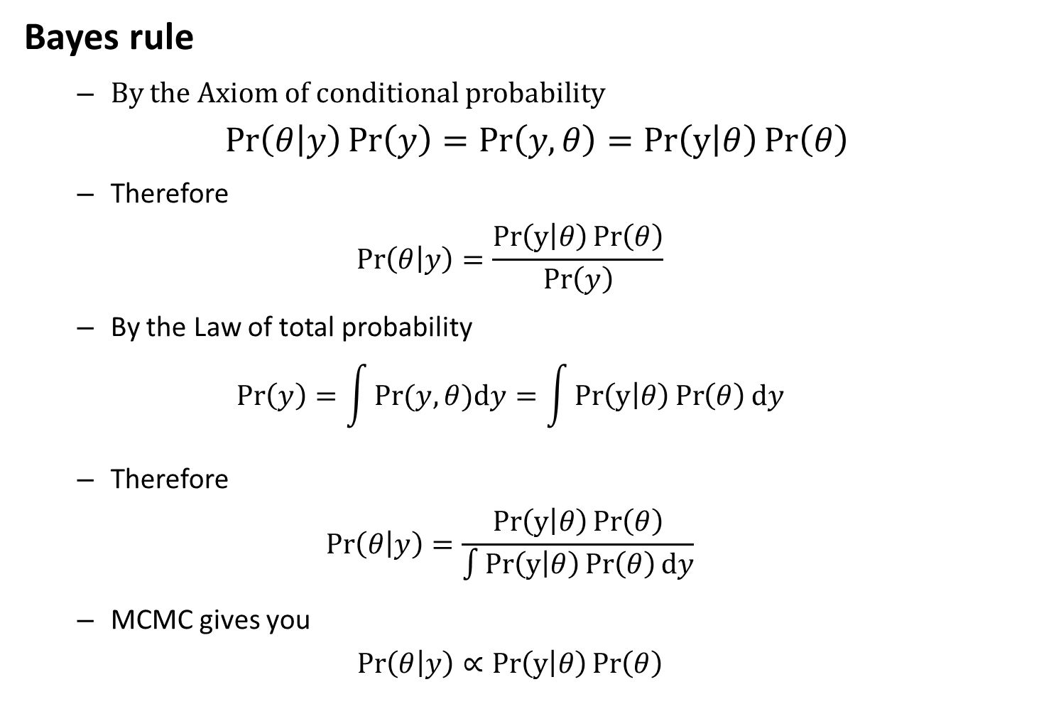
Mixed-effects models
Bayes rule
By the Axiom of conditional probability
$$\operatorname{Pr}\left(θ | y\right)\operatorname{Pr}\left(y\right)=\operatorname{Pr}\left(y,θ\right)=Pr\left(y | θ\right)\operatorname{Pr}\left(θ\right)$$
Therefore
$$\operatorname{Pr}\left(θ | y\right)=\frac{Pr\left(y | θ\right)\operatorname{Pr}\left(θ\right)}{\operatorname{Pr}\left(y\right)}$$
By the Law of total probability
$$\operatorname{Pr}\left(y\right)=\int{Pr⁡(y,θ)dy}=\int{Pr\left(y | θ\right)\operatorname{Pr}\left(θ\right)dy}$$
Therefore
$$\operatorname{Pr}\left(θ | y\right)=\frac{Pr\left(y | θ\right)\operatorname{Pr}\left(θ\right)}{\int{Pr\left(y | θ\right)\operatorname{Pr}\left(θ\right)dy}}$$
MCMC gives you
$$\operatorname{Pr}\left(θ | y\right)∝Pr\left(y | θ\right)\operatorname{Pr}\left(θ\right)$$

Slide 27
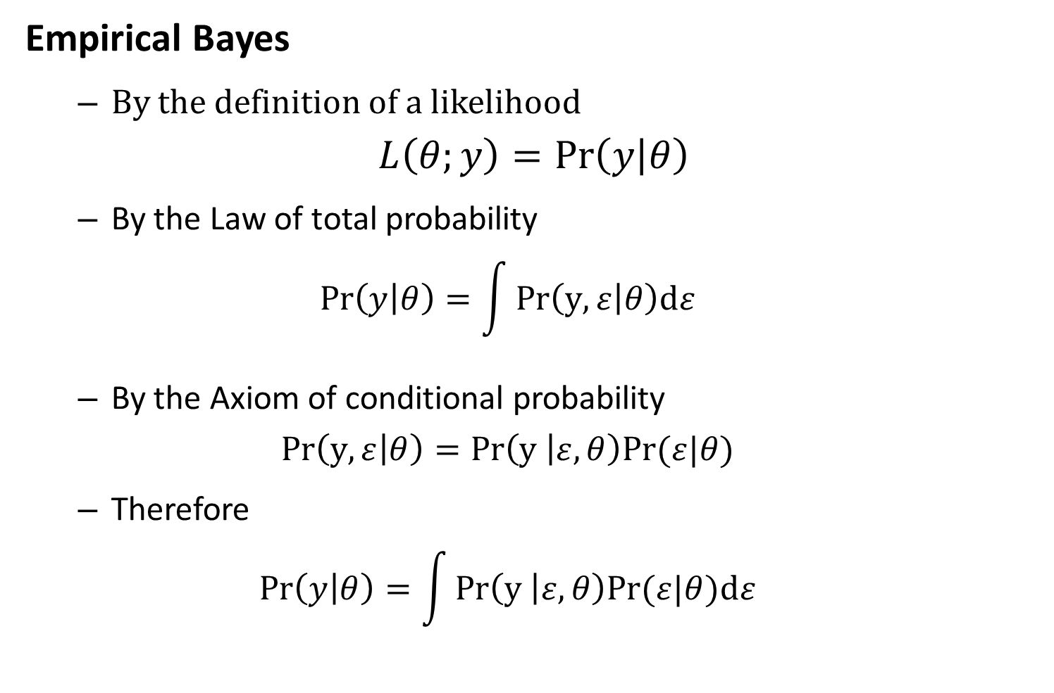
Mixed-effects models
Empirical Bayes
By the definition of a likelihood
$$L\left(θ;y\right)=\operatorname{Pr}\left(y | θ\right)$$
By the Law of total probability
$$\operatorname{Pr}\left(y | θ\right)=\int{Pr\left(y,ε | θ\right)dε}$$
By the Axiom of conditional probability
$$Pr\left(y,ε | θ\right)=Pr\left(y | ε,θ\right)Pr⁡(ε|θ)$$
Therefore
$$\operatorname{Pr}\left(y | θ\right)=\int{Pr\left(y | ε,θ\right)Pr⁡(ε|θ)dε}$$

Slide 28
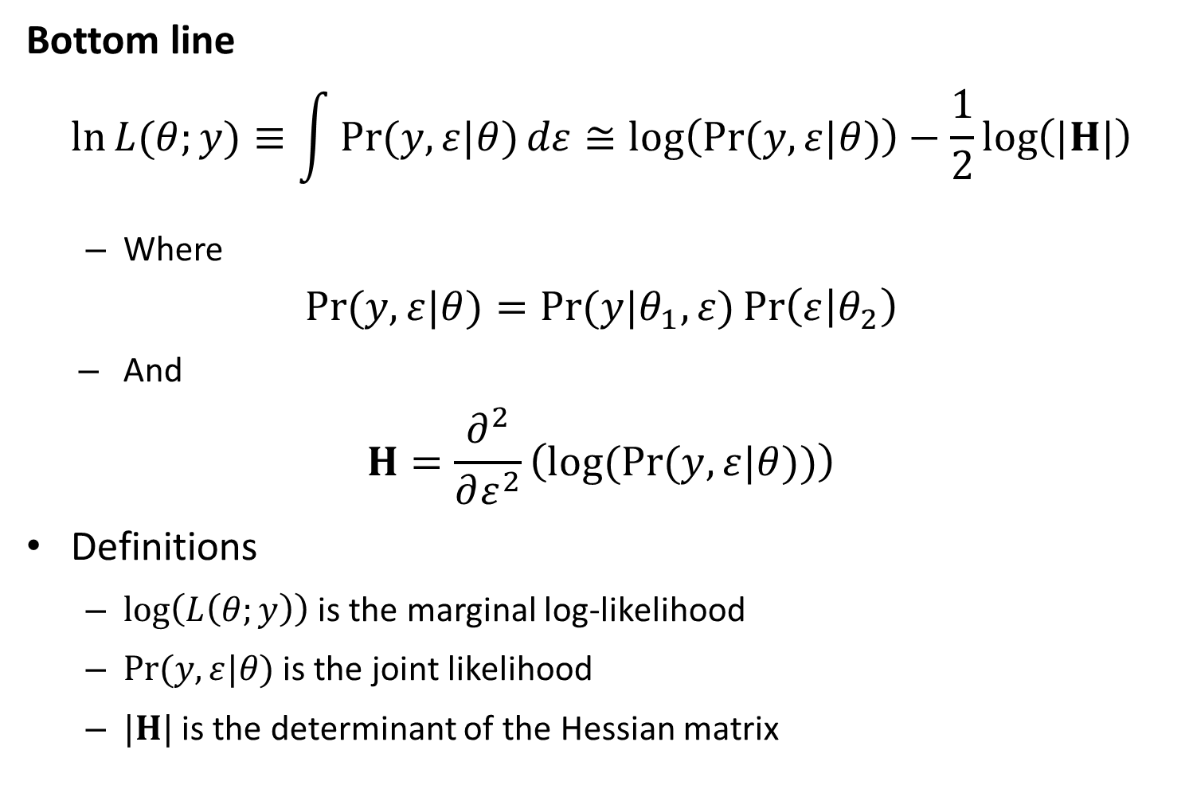
Likelihood statistics
Bottom line
$$\ln{L{(θ;y)}}≡\int{\operatorname{Pr}{(y,ε|θ)}dε}≅\log\left(\operatorname{Pr}{(y,ε|θ)}\right)−\frac{1}{2}\log\left(|H|\right)$$
Where
$$\operatorname{Pr}{(y,ε|θ)}=\operatorname{Pr}{(y|θ_{1},ε)}\operatorname{Pr}\left(ε | θ_{2}\right)$$
And
$$H=\frac{∂^{2}}{∂ε^{2}}\left(log(Pr{(y,ε|θ))}\right)$$
Definitions
$\log\left(L\left(θ;y\right)\right)$ is the marginal log-likelihood
$\operatorname{Pr}{(y,ε|θ)}$ is the joint likelihood
$|H|$ is the determinant of the Hessian matrix

Slide 29
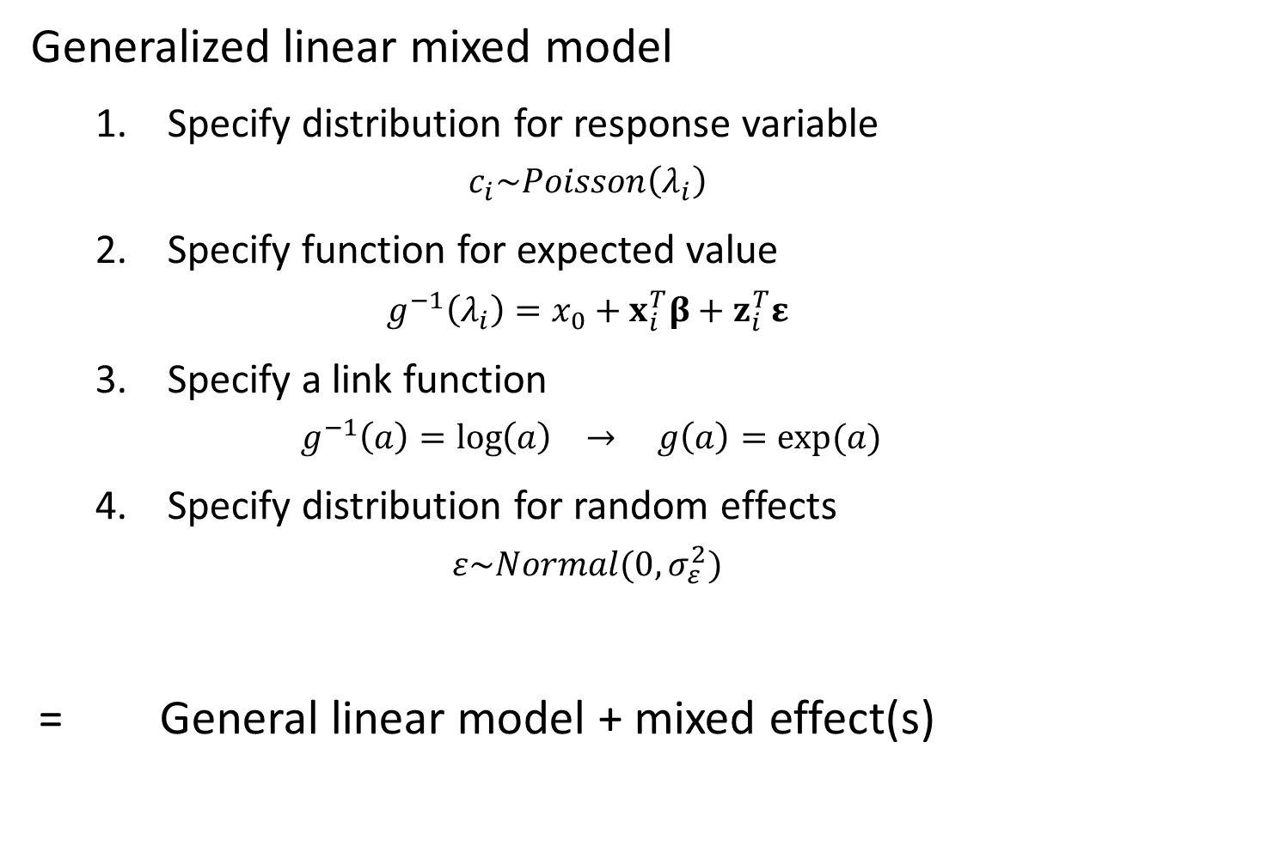
Mixed-effects models
Generalized linear mixed model
Specify distribution for response variable
$$c_{i}\sim Poisson\left(λ_{i}\right)$$
Specify function for expected value
$$g^{−1}\left(λ_{i}\right)=x_{0}+x_{i}^{T}β+z_{i}^{T}ε$$
Specify a link function
$$g^{−1}\left(a\right)=\log\left(a\right) → g\left(a\right)=exp⁡(a)$$
Specify distribution for random effects
$$ε\sim Normal(0,σ_{ε}^{2})$$
= General linear model + mixed effect(s)

Slide 30
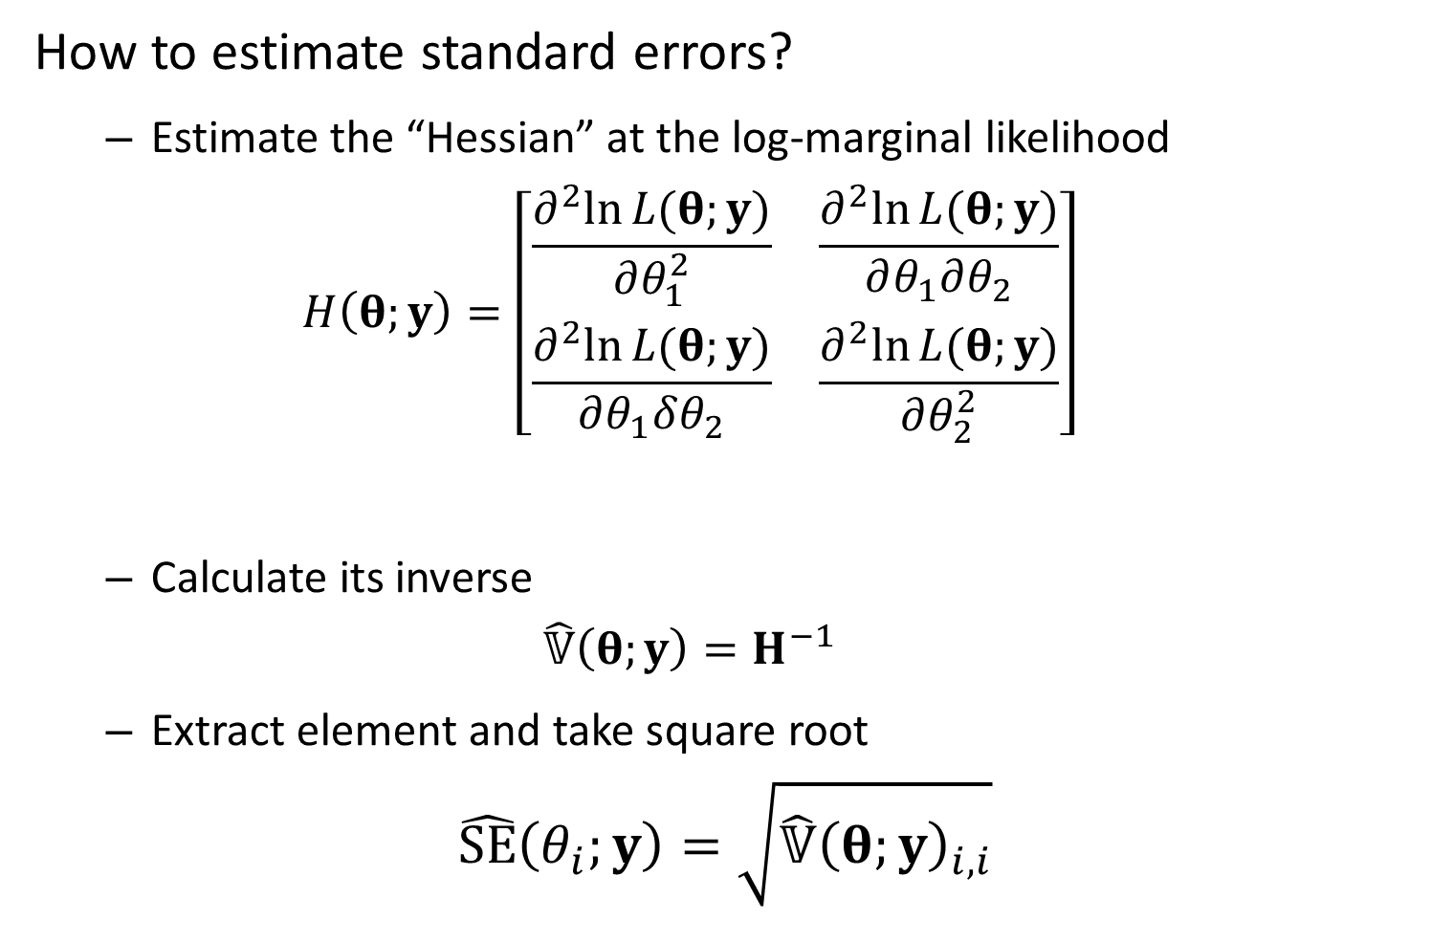
Mixed-effects models
How to estimate standard errors?
Estimate the “Hessian” at the log-marginal likelihood
$$H\left(θ;y\right)=\left[\begin{matrix}\frac{∂^{2}ln⁡L(θ;y)}{∂θ_{1}^{2}} & \frac{∂^{2}ln⁡L(θ;y)}{∂θ_{1}∂θ_{2}} \\ \frac{∂^{2}ln⁡L(θ;y)}{∂θ_{1}δθ_{2}} & \frac{∂^{2}ln⁡L(θ;y)}{∂θ_{2}^{2}}\end{matrix}\right]$$
Calculate its inverse
$$\hat{𝕍}\left(θ;y\right)=H^{−1}$$
Extract element and take square root
$$\hat{SE}\left(θ_{i};y\right)=\sqrt{\hat{𝕍}{\left(θ;y\right)}_{i,i}}$$

Slide 31
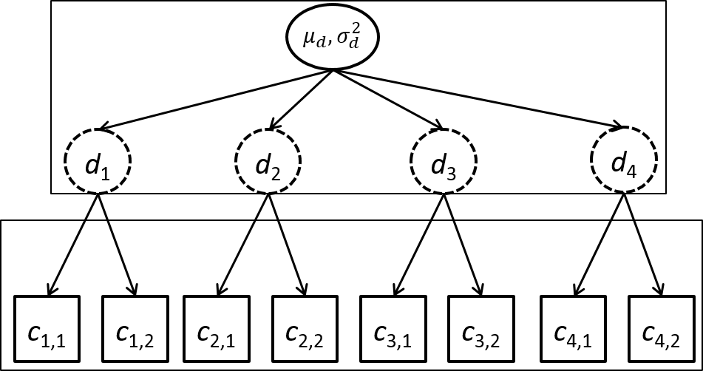

Mixed-effects models
Example – Hierarchical count samples
$$log⁡(d_{j})\sim Normal(μ_{d},σ_{d}^{2})$$
$$c_{i,j}\sim Poisson(d_{j})$$
Counts
4 sites
2 observations/site
3 fixed effects
4 random effects

Slide 32
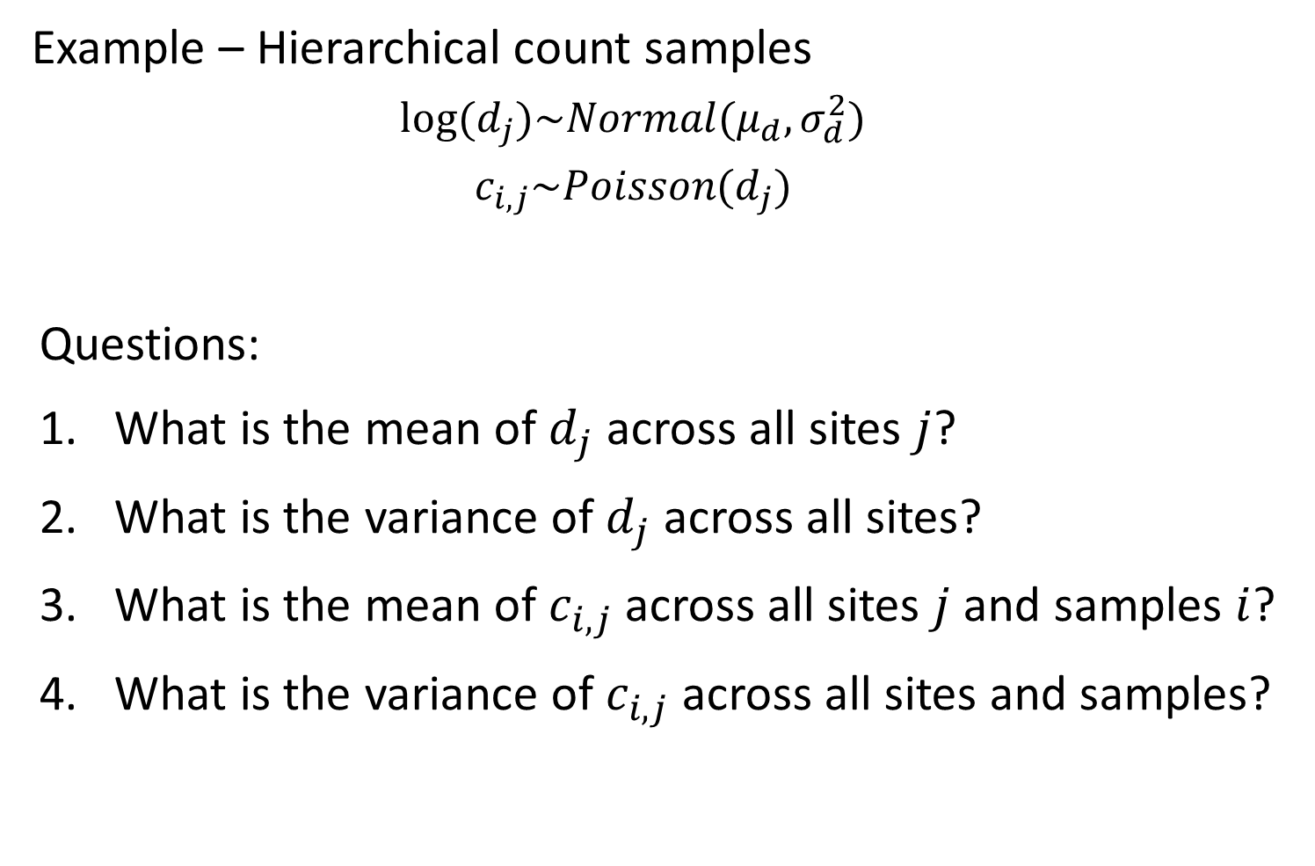
Mixed-effects models
Example – Hierarchical count samples
$$log⁡(d_{j})\sim Normal(μ_{d},σ_{d}^{2})$$
$$c_{i,j}\sim Poisson(d_{j})$$
Questions:
What is the mean of $d_{j}$ across all sites $j$?
What is the variance of $d_{j}$ across all sites?
What is the mean of $c_{i,j}$ across all sites $j$ and samples $i$?
What is the variance of $c_{i,j}$ across all sites and samples?

Slide 33
Mixed-effects models
Benefits of using linear mixed models
Separate estimate of measurement and between-site variability
Include covariates for either one
Improved precision
“Shrinkage”
Draw-backs
Biased if random effects aren’t “exchangeable”

Slide 34
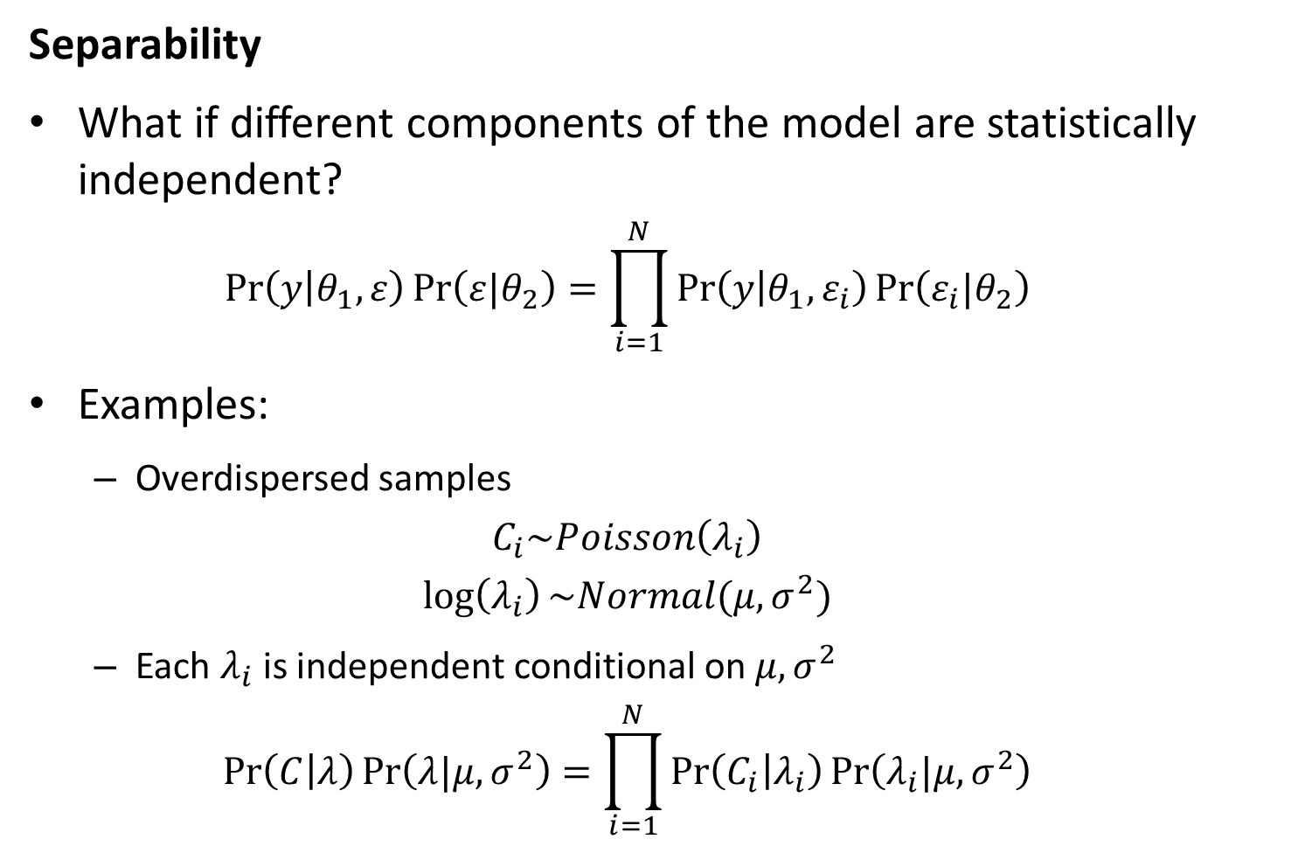
Likelihood statistics
Separability
What if different components of the model are statistically independent?
$$\operatorname{Pr}\left(y | θ_{1},ε\right)\operatorname{Pr}\left(ε|θ_{2}\right)=\prod_{i=1}^{N}{\operatorname{Pr}\left(y | θ_{1},ε_{i}\right)\operatorname{Pr}\left(ε_{i}|θ_{2}\right)}$$
Examples:
Overdispersed samples
$$C_{i}\sim Poisson\left(λ_{i}\right)$$
$$\log\left(λ_{i}\right)\sim Normal(μ,σ^{2})$$
Each $λ_{i}$ is independent conditional on $μ,σ^{2}$
$$\operatorname{Pr}\left(C | λ\right)\operatorname{Pr}\left(λ|μ,σ^{2}\right)=\prod_{i=1}^{N}{\operatorname{Pr}\left(C_{i} | λ_{i}\right)\operatorname{Pr}\left(λ_{i}|μ,σ^{2}\right)}$$

Slide 35
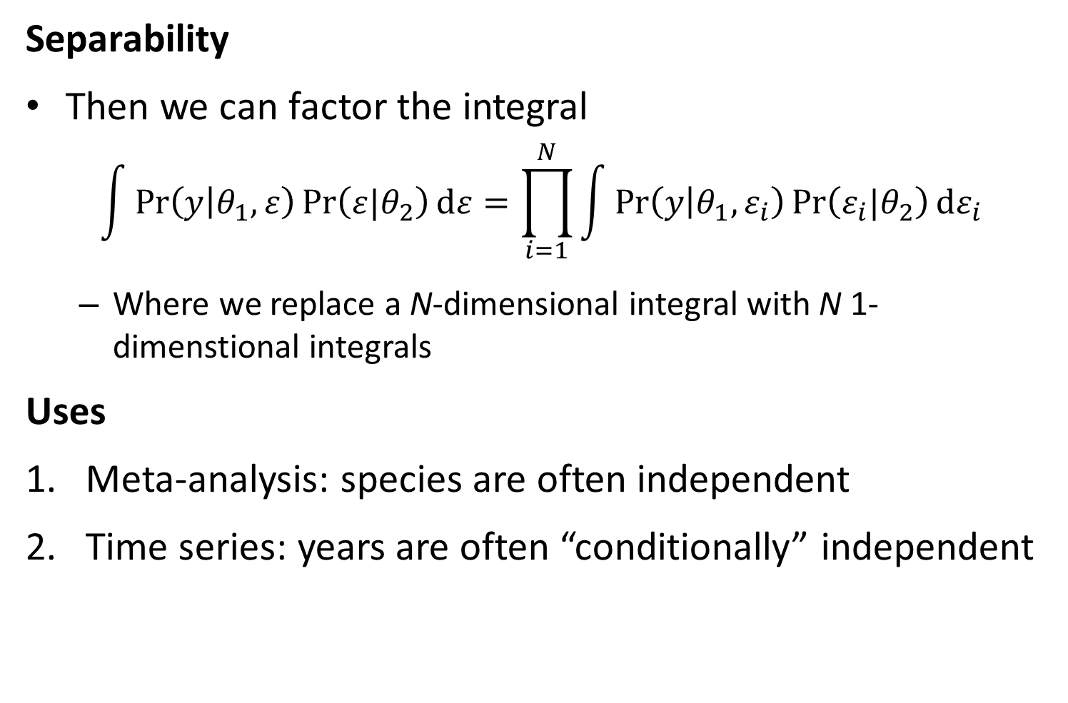
Likelihood statistics
Separability
Then we can factor the integral
$$\int{\operatorname{Pr}\left(y | θ_{1},ε\right)\operatorname{Pr}\left(ε|θ_{2}\right)dε}=\prod_{i=1}^{N}{\int{\operatorname{Pr}\left(y | θ_{1},ε_{i}\right)\operatorname{Pr}\left(ε_{i}|θ_{2}\right)dε_{i}}}$$
Where we replace a N-dimensional integral with N 1-dimenstional integrals
Uses
Meta-analysis: species are often independent
Time series: years are often “conditionally” independent

